Slide 1
Machine Learning for Information Assurance in SCADA Systems
Richard Alcalde, Peter Bayiokos, Constanza Cabrera-Mendoza, Sabrin Kaur Guron, Wildenslo Osias, Charles C. Tappert, Avery Leider, and Krishna Bathula
Seidenberg School of Computer Science and Information Systems
Pace University
Notes:
1 minute
Good evening everyone. We are Team 5. We are the machine learning for information assurance in SCADA systems team. We are accompanied today by our client, Richard Alcalde, our team leader, Peter Bayiokos, myself Constanza Cabrera Mendoza, Sabrin Kaur Guron, and Windenslo Osias. As you already know, we also have our professors Dr. Tappert, Dr. Leider and their assistant Krishna Bathula, on the call.
Our client is a technical specialist from ConEd. He’s been there for 6 years. He has a background in Digital Forensics and Cybersecurity. He showed interest in this project because it is pertains to his work in his industry as a protector of the electricity that’s running each of our devices.
I’d like to now ask my teammates to introduce themselves.
Peter: Hi I’m Peter, I graduate in __ with a Masters in __
Sabrin: Hi I’m Sabrin, I graduate in __ with a Masters in __
Windenslo: Hi I’m Windenslo, I graduate in __ with a Masters in __
Constanza: And I’m C, I graduate in _August_ with a Masters in _IT Cybersecurity_
We’d like to kindly ask that all questions be held until the end of the presentation.

Slide 2
What is a SCADA System?
Supervisory Control and Data Acquisition Systems
Field: Industry Setting
i.e. power plants, manufacturing and assembly lines, chemical plants, water supply networks
Use: Remotely control industrial machines
What is the DANGER?: Technologically dependent systems have high levels of risk if a threat finds a vulnerability. This has a tremendous impact on industries infrastructure and clients.
Notes:
55 seconds
Every day, people around the world wake up and turn on a light switch, use running water, or fill up their car at a gas station. These simple, almost meaningless actions for people in developed countries, actually have an immense, complex back story. The electricity travels all the way to your home from a power plant, the water from a water supply network, the gas from the oil refinery.
The majority of these industries use industrial machines. These implement what is commonly referred to as a supervisory control and data acquisition systems, SCADA for short. These are comparable to remote controls that connect wirelessly to these machines. Like all of the technological innovations of the 21st century, it also faces a major danger: Cyber attacks. If a threat were to find a vulnerability within the SCADA systems protective gear, it would pose a major risk. The industries infrastructure and the people they service could be found in grave situations.

Slide 3
How can we help?
Automation of Cyber-Intrusion Classifications through the use of Machine Learning
Objective: Create a Proof of Concept that demonstrates this is achievable through research of current and past experiments within the field, and implementation of that which we learn
Notes:
40 seconds:
So, how can we help?
One of the major issues that Richard pointed out when we discussed the potential directions our project was the lack of automated classification of intrusions.
History serves as a tool to learn from past mistakes. This concept can be similarly applied to cybersecurity.
By automating the process of cyber-intrusion classification, we can speed up the process of learning from past failures and applying the best tactic to respond to attacks on a system.
Our objective is to create a Proof of Concept that demonstrates this is achievable through research of the field, and implementation of that which we learn during our research

Slide 4
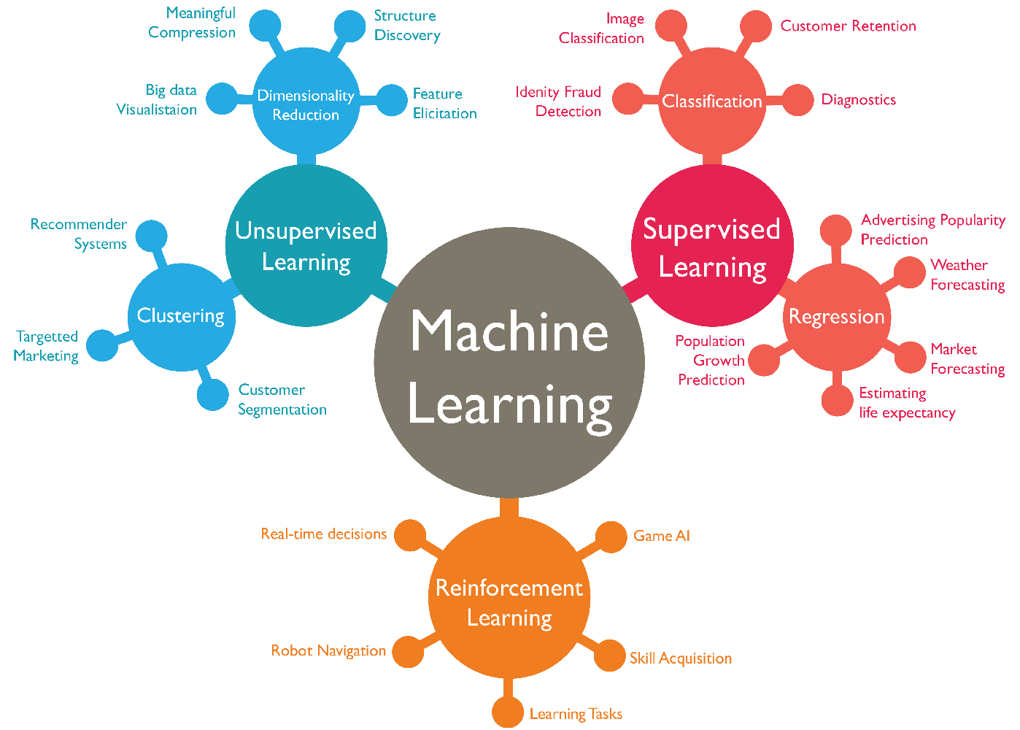
Machine Learning: A Quick Review
ML a variety of methods to teach a machine to recognize specific patterns and use this to identify and classify data
Unsupervised Learning
Supervised Learning
Reinforcement Learning
We selected: Reduced Error Pruning Tree (Classified as a supervised learning algorithm)
Notes:
55 seconds
This slide is a quick review on Machine Learning for those of us who have had a few semesters since they last saw anything of this nature. Machine learning uses methods to teach a machine to recognize patterns to identify and classify data. There are three major branches, as denoted here. Unsupervised, supervised, and reinforcement learning. We decided to go with the first category, specifically using the REPTree for it’s efficiency in our specific requirements.
As we performed Chapter Breakdowns and evaluated our resources, we redefined our scope a few times throughout the semester. We went from let’s use an algorithm from each category and 3 different data sets! To lets use a partial data set and specific, parameter edited algorithm that has already proved strength in this field. We learned the hard way to clarify our objectives and properly narrow our scope into a feasible objective.

Slide 5
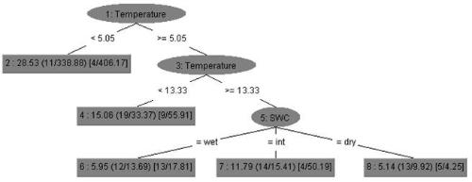
Reduced Error Pruning Tree
Decision making tree algorithm
Based off of C4.5, data mining algorithm for data classifying.
Reduces errors by replacing nodes with most popular classes
Notes:
50 seconds
The REPTree algorithm is a decision tree learner based on the C4.5 algorithm. C4.5 is used primarily in data mining for decision tree classifiers. The algorithm generates a decision based on a sample of labeled data.The REPTree produces both a classification or a continuous outcome, which makes it unique over C4.5. Additionally the REPTree offers reduced error pruning, which replaces each node with it’s most popular class. This effort of pruning is simple and efficient \cite{al2011suite}. Essentially, these algorithms analyze a piece of data, and then make a decision based on two different factors. Each decision factor produces its own result, which makes it a tree with branches.

Slide 6
Literature Review Performed
Security Issues in SCADA Networks, (2006)
Sustainable Security for Infrastructure SCADA, (2003)
Guide to Industrial Control Systems (ICS) Security, (2011)
A Survey of Approaches Combining Safety and Security for Industrial Control Systems, (2015)
Notes:
30 seconds
Of course, we had to back up our reasoning for the importance of such a solution. Our literature review included a handful of peer-reviewed articles and research papers, the most notable of which are mentioned here. They range from ‘03 to ‘15, as progress is still in development for this issue. This research also led us to the basis of rules that we would connect our machine learning to for accurate parameter creation.

Slide 7

MITRE ATT&CK for Industrial Control Systems Framework
Knowledge base to determine actions taken by attackers
Describes tactics, techniques, software, and groups
Use framework to gain clarity on attack type, severity level, and remediation steps.
Notes:
40 seconds
The MITRE ATT&CK for Industrial Control Systems Framework consists of a knowledge base used to identify and classify actions taken by attackers. It includes a large variety of tactics, techniques, software and origins. This framework helps the cybersecurity team in the respective industry to further understand an intrusion, it’s severity, and how to best approach remediation. This is the framework we used to refine the parameters for our machine learning algorithm, and make it more appealing to our client.

Slide 8
Implementing the Information Learned
We will be using a data processing tool, Weka, to classify our dataset.
The machine learning algorithm being used to classify will be the REPTree to better make decisions of the type of attack.
Once the ML algorithm determines the attack based on our data points, we move into the framework.
The ATT&CK for ICS framework will assist in determining the type of attack tactic as well as the severity level.
We will combine all of this to create an automated alerting system for SCADA and Industrial Control systems.
Notes:
40 seconds
We used a data processing tool called WEKA to initially classify our data set.
The REPTree previously mentioned was taught to first identify the type of attack based on the sample data set.
Once this was learned, we applied the ATT&CK for ICS Framework to further classify the type of attack, and attach a severity tag.
This now automated algorithm can be transformed into a tool for alerting a cybersecurity team to attacks within a SCADA and Industrial Control System! All it takes is a little coding and some UX Design to make a more attractive tool.

Slide 9

See Our Model in ACTION!
Notes:
1 minute
This is a quick video demonstrating the process in which input data is automatically classified.
Using Weka we input the data set, go into its classification-functionality and choose our REPTree classifier.
Then, we set the search parameters and selected an attribute.
From there, it applied the classifying algorithm to our dataset using the attribute we choose.
From what you see on the resulting data set has been adequately classified.

Slide 10

Potential Next Steps, (if endorsed)
Create a high/mid-level prototype of the alert system including the following features:
User-friendly GUI
Immediate alert system to end-user
Sustainability across different OS and platforms
Adaptability to different industries
Notes:
30 seconds
If our project is considered a viable course of action, our next steps would be to create a high/mid level prototype of the alert system. We would include a User Friendly GUI, an alert system for the end-user, make it a sustainable tool across different operating systems and device platforms, and make it adaptable to a variety of industries. Since our test system used a gas pipeline dataset, we’d teach it to understand datasets from other industries.
https://depositphotos.com/243776794/stock-illustration-illustrations-concept-technology-startup-company.html

Slide 11
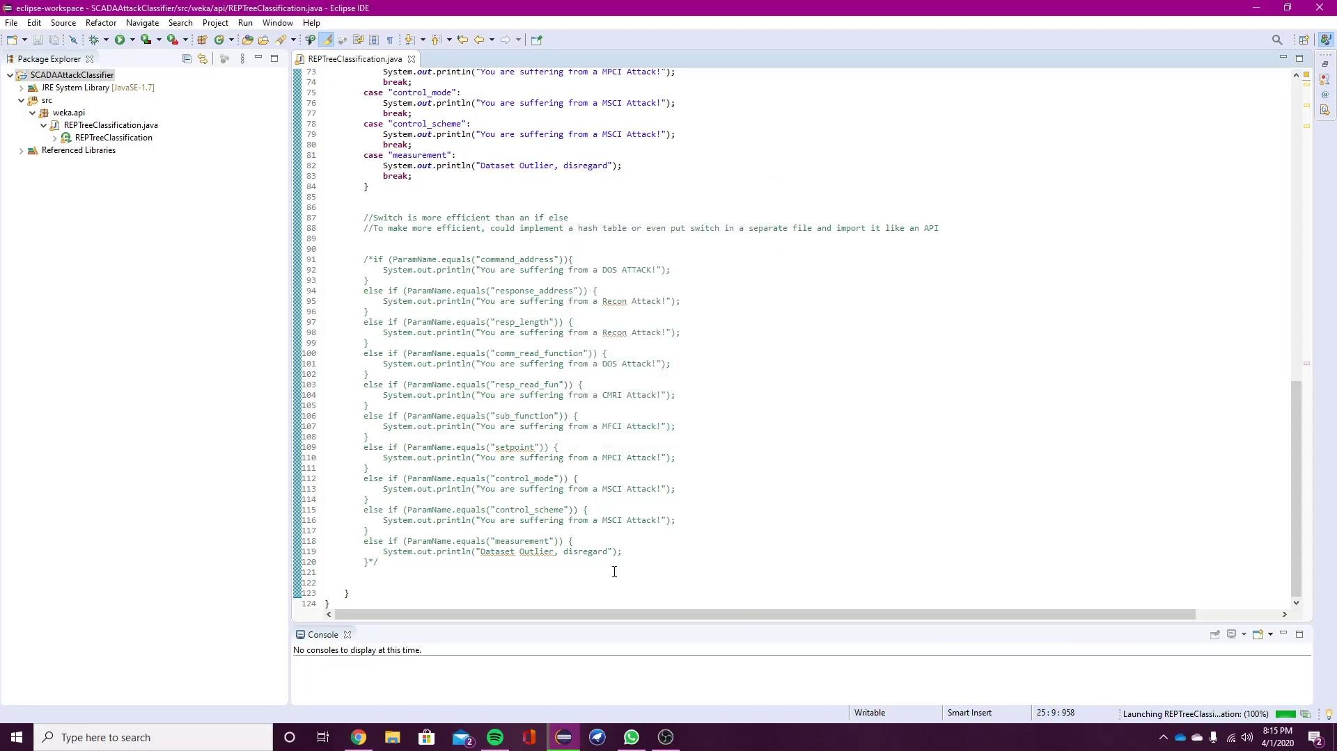
MVP (Minimum Viable Product)
Notes:
40 seconds
Since our work served as a Proof of Concept, we decided to provide with a taste of what a Minimum Viable Product would look like. This is the result of implementing the initial classified data set, teaching the machine learning algorithm the parameters for classification, applying the ATT&CK framework, and putting it all into a JAVA program that would make it a simple run of the program for the end user. This is, of course, just a the bones of the MVP, but it is an incredible addition to our work as it proves it’s a feasible product to offer our client.

Slide 12


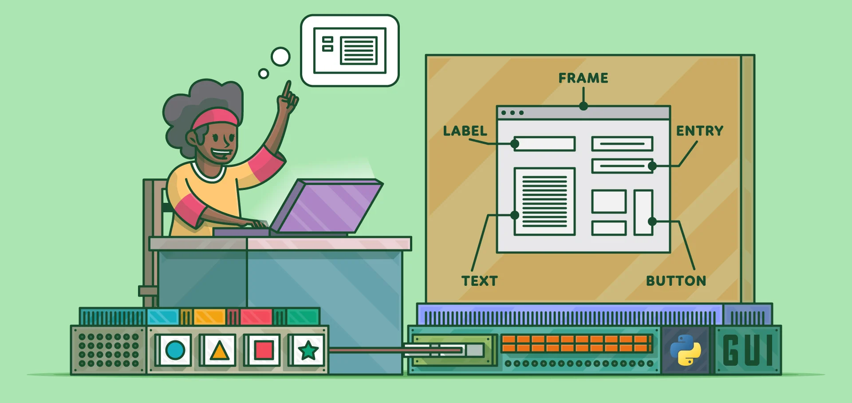
Development Options
Working with various Industries
Web-Based Application
Notes:
30 seconds
As a finalization to our project, we researched a few web-based applications, industries that might have an interest in our project, and different graphic user interface software that might help to better our product. These are further detailed in our implications, recommendations and potential next steps. Our resulting information gathered demonstrates a high potential for our product once endorsed for further developed, and we hope that this is recognized by our client.

Slide 13
Please direct any questions, concerns, or comments to pb10842p@pace.edu
We will appreciate any and all constructive feedback!
(Team 5 - Machine Learning for Information Assurance in SCADA Systems)
Notes:
15 seconds
Thank you all for listening, we are very proud of the work and collaboration we’ve had between ourselves, with our client, and our professors. We’d be happy to answer any questions, concerns, or receive any feedback. We’re always happy to welcome more innovation.

